Slide 1

Introduction
A Hands-on Exploration of the Azure OpenAI API
30.05.2024

Slide 2
13:30 – 14:00
Introduction to Azure OpenAI Service (Part 1)
Workshop Preparations (Part 2)
Using the Azure OpenAI API (Part 3)
15:00 – 15:30
Coffee Break
15:30 – 16:45
Retrieval-Augmented Generation (Part 4)
Fine-Tuning (Part 5)
Image-to-text using GPT4o (Part 6)
16:45 – 17:00
Extras | Q&A

Slide 3
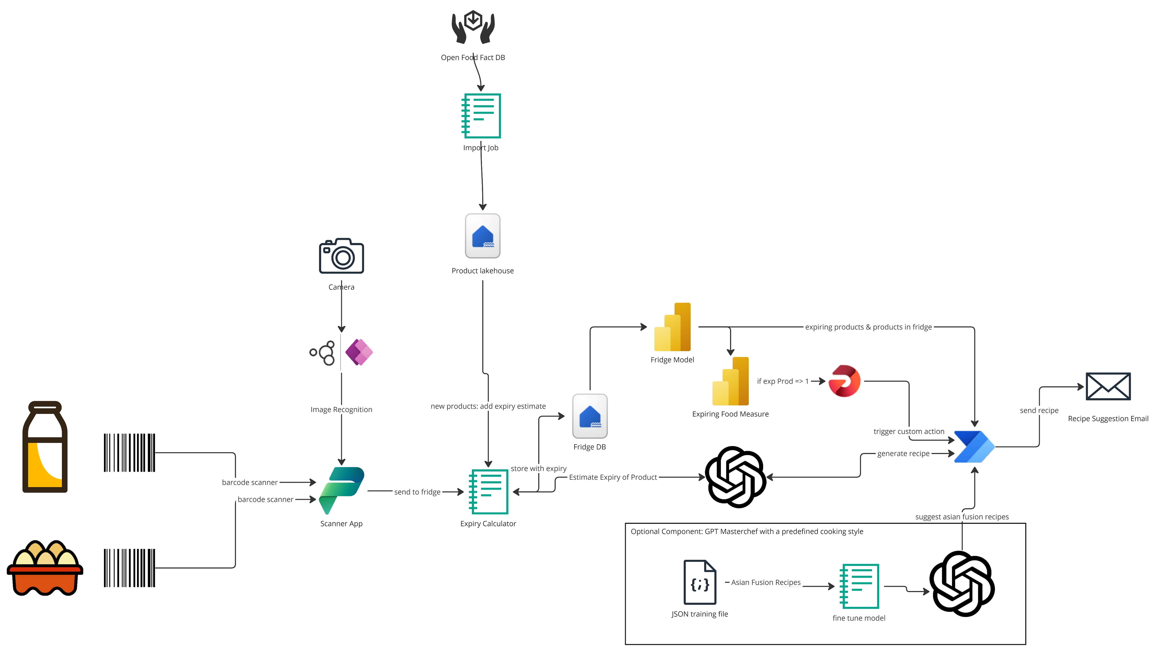
Workshop Use Case

Slide 4
Introduction to Azure OpenAI Service
A Data Lakehouse is a data management architecture that combines the key advantages of data lakes and data warehouses into one.
What makes the Data Lakehouse so special is that the data lake essentially acts as the data warehouse. In other words, a relational database layer is added over the data in a data lake.
By additionally storing the data in the Delta Lake format, important functionalities such as ACID compliance, schema enforcement and layout optimization, that were previously only available in data warehouses, now become available on the data lake as well.
This allows for data querying directly on the data lake. For comparison, in traditional data warehouses, the data would first need to be imported and stored on disk, before being available for querying.

Slide 5
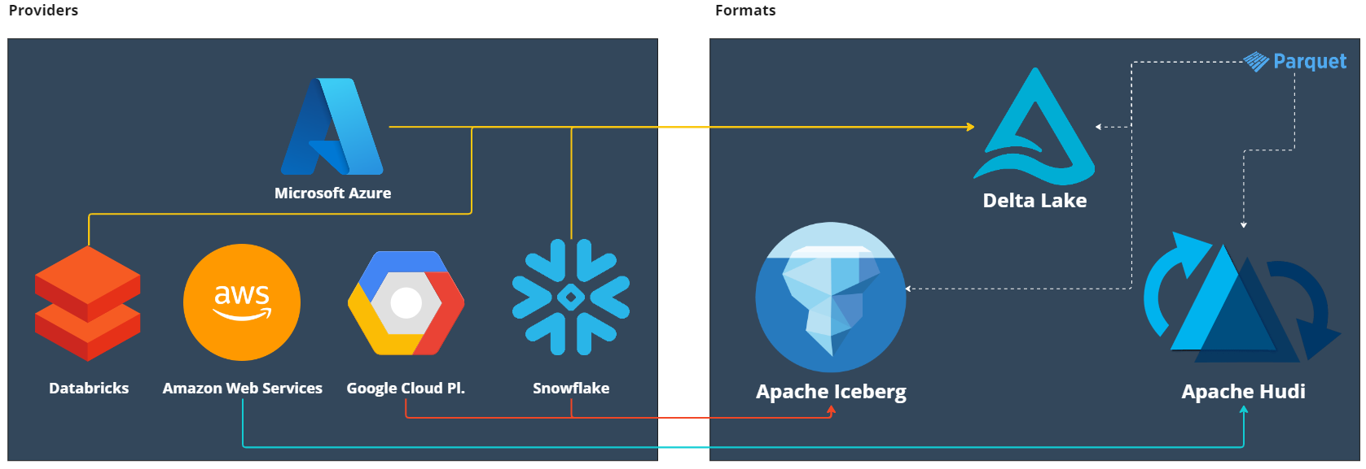
Data Formats
Parquet is an open-source file format, and Delta is an open-source file protocol that stores data in Parquet files.

Slide 6
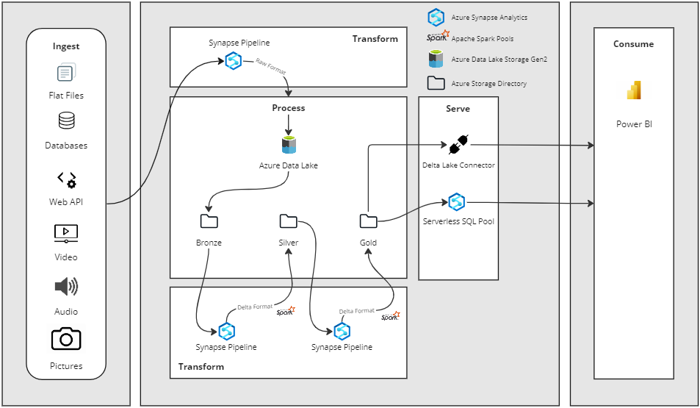
Data Lakehouse Architecture

Slide 7
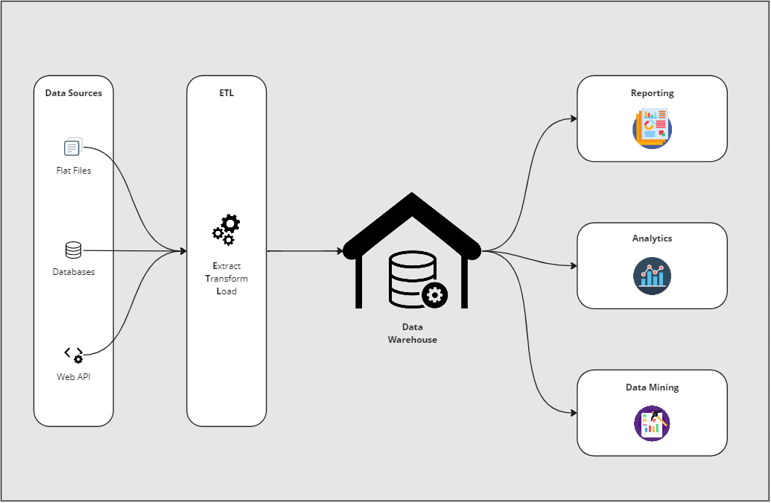
Data Warehouses
Stores structured data in a predefined schema from multiple sources to perform queries and analysis for business intelligence.
But….
No Support for Unstructured Data
Limited support for ML workloads
SQL-only
Scaling up and maintenance is costly
Vendor lock-in
Building a Lakehouse Architecture with Azure Databricks with Christopher Chalcraft - YouTube

Slide 8
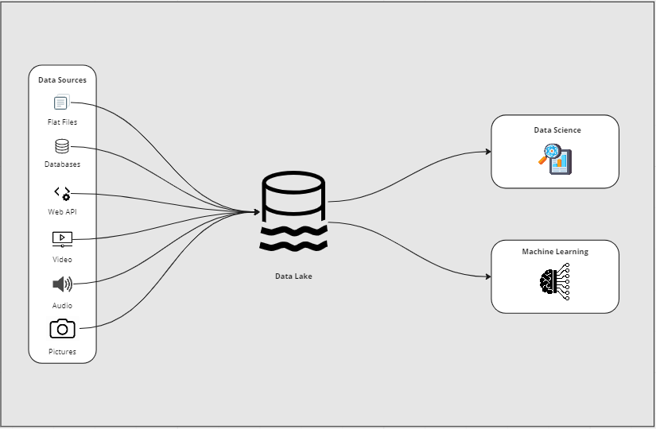
Data Lakes
Stores structured, semi-structured or unstructured data without a predefined schema from multiple sources to perform advanced analytics.
But….
Low data quality (Data Swamp)
Poor performance
Limited BI support
Arduous raw data exploration
Building a Lakehouse Architecture with Azure Databricks with Christopher Chalcraft - YouTube

Slide 9
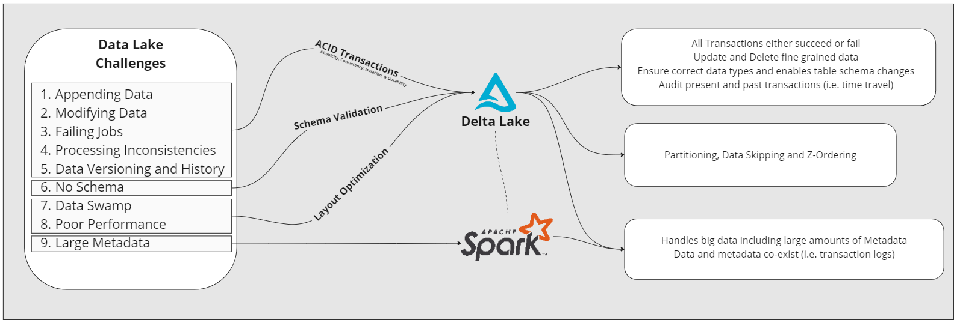
Delta Format to the Rescue
Building a Lakehouse Architecture with Azure Databricks with Christopher Chalcraft - YouTube

Slide 10
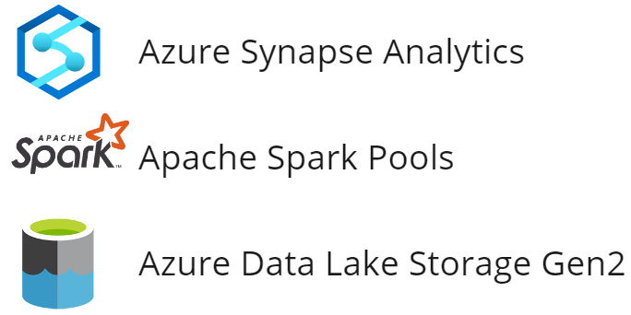
Creating a Data Lakehouse
The architecture will be composed of the following Azure resources:
These need to be provisioned before we start.

Slide 11
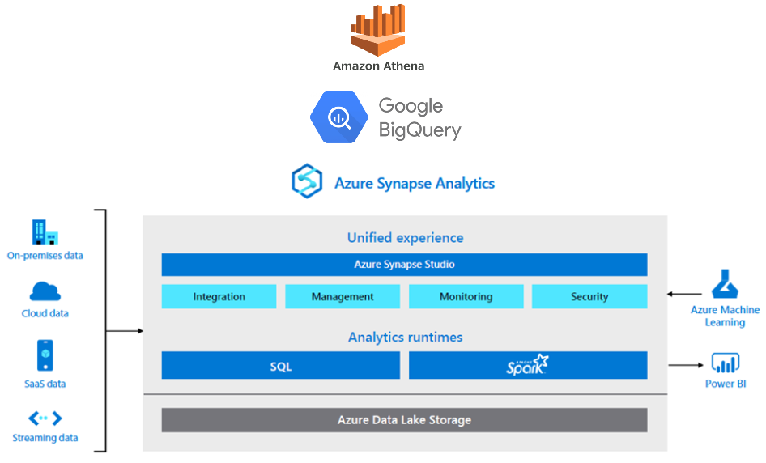
Azure Synapse Analytics
Cloud data warehouse offering a unified experience for data preparation, data management, data warehousing, big
data, and AI tasks.
Benefits….
Low implementation and maintenance costs
Low storage costs
No infrastructure to manage
Pay only for what is needed (pause consumption)
Independently scale storage from compute
Etc.
Empower IT and Data Professionals to Achieve More with All Their Data (azureedge.net)

Slide 12

https://tinyurl.com/dlhworkshop1
Scan the QR code and open the git repository on your PC
QR Code Generator (the-qrcode-generator.com)

Slide 13

Extras | Q&A

Slide 14
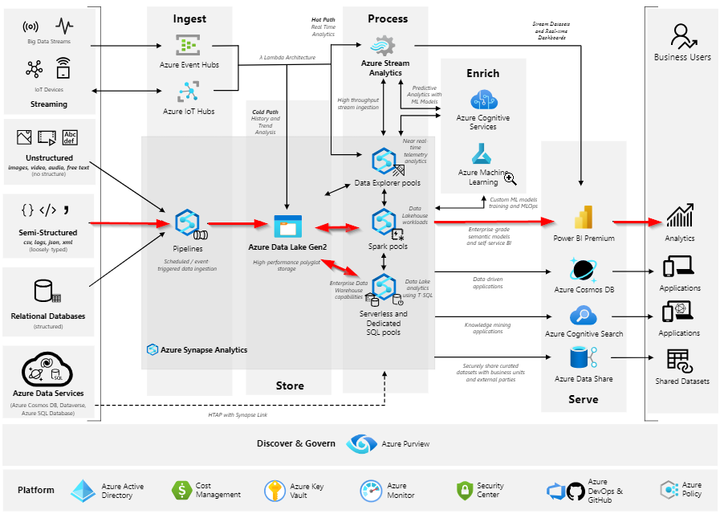
Full Architecture using Azure Synapse Analytics
Example:
Analytics end-to-end with Azure Synapse - Azure Architecture Center | Microsoft Learn

Slide 15
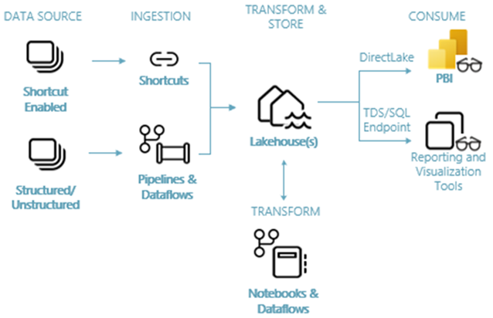
Microsoft Fabric
Fabric Lakehouse end-to-end architecture:
Lakehouse end-to-end scenario: overview and architecture - Microsoft Fabric | Microsoft Learn

Slide 16

Questions?

Slide 17
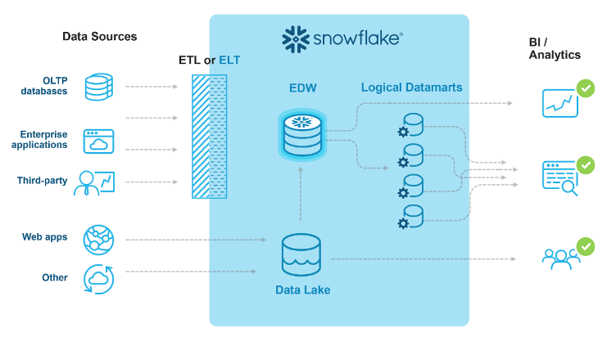
Snowflake
Data Lakehouse architecture:
Snowflake - A Hybrid of Data Warehouse and Data Lake

